Slide 1
Designing an Enterprise ML Architecture with AWS ML Services

Slide 2
Introduction to Enterprise ML Platforms
Why Enterprise ML Platforms? Supports multiple ML initiatives with scalability, automation, and robust operations.
Complexity of ML Platform Design: Balancing architecture for fast-moving development, model deployment, and lifecycle support.
Chapter Objectives: Workflow automation, infrastructure scalability, and comprehensive monitoring.
Core Topics: Key components, personas, requirements, and architecture best practices.

Slide 3
Personas in ML Platforms
ML Platform Builders: Responsible for designing and building the platform’s infrastructure.
ML Platform Users: Data scientists, engineers, and analysts focused on model development and usage.
Platform Operators: Ensure ongoing maintenance, optimization, and security.
ML Solutions Architect: Acts as a bridge, guiding builders, users, and operators to maximize platform potential.

Slide 4
Key Roles in ML Platform Building
Cloud Infrastructure Architect: Designs cloud components and selects services for scalability and resilience.
Security Engineer: Implements data protection measures and manages compliance with industry standards.
ML Platform Product Manager: Defines user requirements, platform capabilities, and implementation roadmap.
Data Engineers: Build data pipelines for efficient data processing and storage.

Slide 5
Platform Users and Operators
Data Scientists and ML Engineers: Conduct data exploration, model training, and inference optimizations.
Model Testers and Validators: Assess model reliability, detect issues, and ensure models align with business objectives.
Operations Engineers: Handle platform maintenance, upgrades, incident management, and performance monitoring.
AI Risk and Governance Managers: Ensure responsible AI practices and regulatory compliance.

Slide 6
Typical ML Workflow in an Enterprise
Data Collection and Processing: Gather data from diverse sources and prepare for ML tasks.
Data Exploration and Hypothesis Formation: Experiment with different models and features.
Model Training and Tuning: Train models on full datasets with refined parameters.
Validation and Risk Assessment: Test model performance, detect risks, and validate against business goals.
Deployment and Monitoring: Deploy validated models, monitor for data drift, and ensure performance.

Slide 7
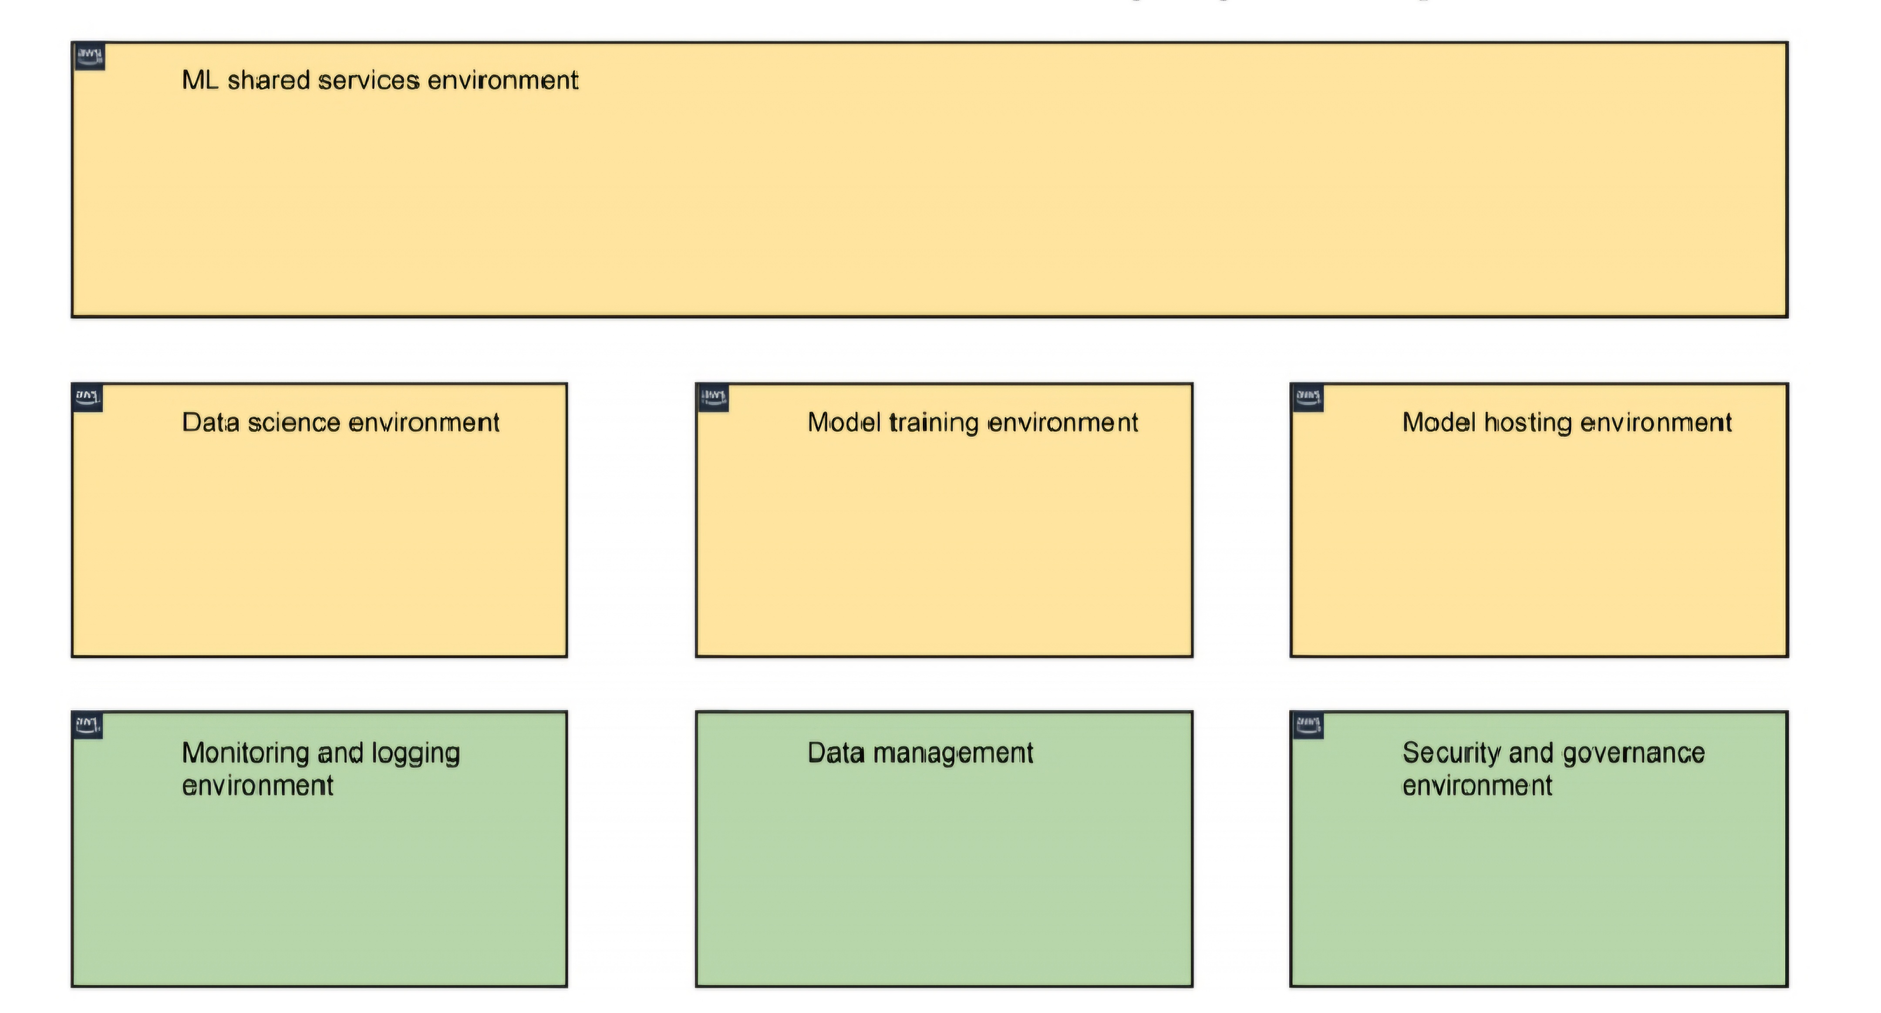
Enterprise ML architecture environments

Slide 8
Requirements for an Enterprise ML Platform
End-to-End ML Lifecycle Support: From data prep and experimentation to production deployment.
CI/CD and Continuous Training (CT): Automated model retraining and deployment based on data or model drift.
Operations and Monitoring Support: Monitor errors, pipeline workflows, and infrastructure health.
Compatibility with Various Frameworks: Flexibility for different ML frameworks (e.g., TensorFlow, PyTorch).

Slide 9
Essential Platform Features for ML Users
Libraries and Tools Access: Provide access to ML libraries, tools, and frameworks.
Data Access and Processing: Enable seamless data access and automated data retrieval.
Model Testing and Validation Tools: Offer tools for model evaluation, bias detection, and interpretability.
Compliance and Governance Support: Include workflows for model approval and compliance validation.

Slide 10
Platform Requirements for Specific Roles
Data Scientist Needs: Libraries, frameworks, automation for data retrieval, feature engineering, and model versioning.
Model Tester Needs: Access to test datasets, visualization tools, statistical testing, and bias detection tools.
Ops Engineers: Require comprehensive access to platform infrastructure, code repositories, and monitoring tools.
AI Risk Officer: Access to assessment tools, governance platforms, and fairness/bias assessment tools.

Slide 11
Core Components of Enterprise ML Architecture
Model Training Environment: Resources for training, hyperparameter tuning, and persistence.
Model Hosting Environment: Hosts trained models for real-time or batch inference, with multiple stages for testing and production.
Shared Services Environment: Includes common tools, repositories, CI/CD tools, and model registries.

Slide 12
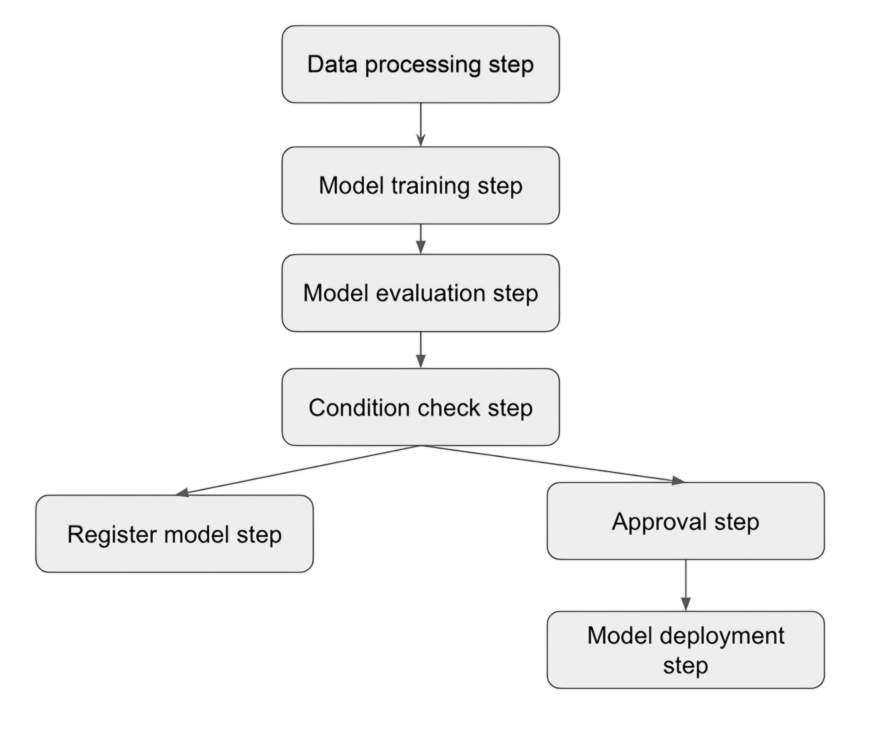
Sample ML pipeline flow

Slide 13
Model Training Environment
Controlled Environment: Policies and procedures ensure security, resource isolation, and job management.
Training Capabilities: Support for multiple ML frameworks, distributed training, and hardware options (CPUs, GPUs).
Security Measures: Network, job, and artifact isolation with strict monitoring and logging.
Training Job Monitoring: Track progress, system resource usage, and model performance metrics.

Slide 14
Model Hosting Environment
Inference Capabilities: Support for various ML frameworks with custom or pre-built inference engines.
Multi-Stage Hosting: Separate environments for testing and production to manage and test model performance.
Automation and Workflow Integration: API access and scripting for endpoint deployment in automated workflows.
Security Controls: Access control for management and data endpoints, with audit logging for compliance.

Slide 15
Supporting Services Environment
Central Repository Access: Code repositories, Docker registries, and feature stores accessible to all platform users.
CI/CD Pipelines and Automation Tools: Support automated deployment, model lifecycle management, and infrastructure setup.
Service Catalogs: Pre-configured services and tools for faster provisioning and setup.

Slide 16
MLOps Practice Overview
Consistency in Processes: Standardized model-building and deployment processes for reliable outcomes.
Reusable Tooling and Templates: Common tools for pipeline orchestration, model registry, and CI/CD.
Model Reproducibility: Track all inputs, code, and artifacts for easy tracking and validation of experiments.
Scalable Delivery: Run multiple ML pipelines in parallel to handle high-demand production workflows.

Slide 17
MLOps Architecture Components
Code Repositories: Control versioning and act as triggers for pipeline execution.
Feature Store: Centralized storage for reusable features across projects, simplifying data preparation.
Container Repository: Stores container images for various pipeline stages.
Model Registry: Tracks model versions, metrics, lifecycle statuses, and deployment approvals.

Slide 18
Monitoring and Logging for ML Platforms
Comprehensive Metrics Collection: Track CPU/GPU utilization, model performance, and pipeline status.
Alerts for Key Metrics: Set alarms for abnormal conditions (e.g., low CPU utilization, high latency).
AWS CloudWatch Integration: Aggregates logs and metrics, supporting dashboards and custom alerting.
Automated Notifications and Responses: Uses SNS for alerts; responds to conditions via AWS Lambda functions.

Slide 19
Model Training Monitoring
Resource Utilization Tracking: Provides insights into CPU/GPU usage, storage, and memory allocation.
Training Job Status and Progress: Track training completion, errors, and bottlenecks in job performance.
Bias Detection and Explainability: Monitor model fairness and feature importance across iterations.
Issue Detection: Track data skew, bottlenecks, and configuration issues to optimize model training efficiency.

Slide 20
Model Endpoint Monitoring
Performance Monitoring: Tracks system performance metrics like latency, memory usage, and CPU/GPU utilization.
Data Drift and Model Drift Detection: Identifies changes in input data distribution and model performance.
Quality Metrics Tracking: Includes metrics like accuracy, F1 score, precision, and recall for real-time insights.
Inference Explainability: Highlights influential features for model predictions, helping understand model decisions.

Slide 21
ML Pipeline Monitoring
Pipeline Execution Tracking: Monitors task progress, step completion, and error events.
Stage and Action-Level Status: Allows detailed troubleshooting and error correction at each pipeline stage.
CloudWatch Integration: Aggregates metrics and alerts, with EventBridge supporting automated responses.
End-to-End Pipeline Observability: Ensures visibility and reliability across multiple production pipelines.

Slide 22
Service Provisioning and Management
Data Science Environment Setup: Automates setup of workspaces, libraries, and access controls for teams.
ML Pipeline Provisioning: Pre-configures automation pipelines for data scientists and engineers.
AWS Service Catalog for IT Management: Centralized portfolio with standardized templates for easy access.
Hub-and-Spoke Model: Central management of resources across multiple accounts for organization-wide access.

Slide 23
Best Practices for ML Platform Execution
Cross-functional Collaboration: Involve diverse teams (DevOps, data engineering, and ML experts) for enriched design.
Governance Processes Early On: Define model verification, explainability, and ethics to enforce responsible AI.
Pilot ML Workloads First: Implement initial projects on the platform to identify improvements.
Phased Execution: Execute in stages to allow iterative learning and platform scaling.

Slide 24
Best Practices for Platform Design and Operations
Managed Services as Defaults: Use AWS’s built-in services to minimize setup and simplify maintenance.
CI/CD Pipelines: Use tools like CodePipeline and CodeBuild to automate deployments.
Self-service Capabilities: Empower users to perform tasks independently within secure boundaries.
Centralize Model and Feature Repositories: Improves collaboration, consistency, and compliance.

Slide 25
Platform Use and Operations Best Practices
Cost Optimization: Use spot instances, autoscaling, and price-based configurations.
Change Management Protocol: Establish structured processes for model/platform changes and updates.
Incident and Response Planning: Develop clear procedures for timely issue detection and resolution.
Resource Tagging and Tracking: Ensure organization and visibility through a consistent tagging strategy.

Slide 26
Conclusion and Summary
Comprehensive Platform Design: Supports the end-to-end ML lifecycle, automation, and monitoring.
Key Components Recap: Model training, hosting environments, shared services, and MLOps tools.
Long-term Vision: Balance innovation and governance, and prioritize scalability and security.
Empowering Enterprise AI: Effective ML platforms democratize AI, making ML capabilities available to both technical and business users.

